Slide 1
CE 5362 Surface Water Modeling
1D/2D Hydrodynamic Models

Slide 2
Open Channel Flow
Review of important terms
Derive (plausibility argument) St. Venant (1D-spatial)
Algorithms
Steady – variable space step
Steady – fixed space step

Slide 3
Review of Terms
Steady flow
Uniform
Gradually varied
Rapidly varied
Unsteady flow

Slide 4
St. Venant Equations
Continuity
Lateral inflow
Momentum
Pressure
Gravity drive
Friction Loss
Notes:
If the same inputs (in an algorithm) produce different results, but similar statistical behavior (stochastic)

Slide 5
Computational Cell
Topwidth (B) is a function of depth (and geometry)
Here using z as flow depth variable
Notes:
If the same inputs (in an algorithm) produce different results, but similar statistical behavior (stochastic)

Slide 6
Conservation of Mass
qΔx
M_{in} = mass flow into cell
q * Δx = lateral mass inflow
M_{out} = mass flow out of cell
M_{storage} = rate of mass stored in cell
Notes:
If the same inputs (in an algorithm) produce different results, but similar statistical behavior (stochastic)

Slide 7
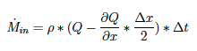
Conservation of Mass
M_{in} = mass flow into cell
+ρq ΔxΔt
Notes:
If the same inputs (in an algorithm) produce different results, but similar statistical behavior (stochastic)

Slide 8
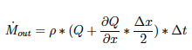
Conservation of Mass
M_{out} = mass flow out of cell
Notes:
If the same inputs (in an algorithm) produce different results, but similar statistical behavior (stochastic)

Slide 9
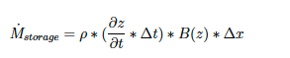
Conservation of Mass
M_{storage} = rate of mass stored in cell
Notes:
If the same inputs (in an algorithm) produce different results, but similar statistical behavior (stochastic)

Slide 10
Conservation of Mass
Assemble the conservation equation: M_{in} - M_{out} - M_{storage} = 0
+ρq ΔxΔt
Notes:
If the same inputs (in an algorithm) produce different results, but similar statistical behavior (stochastic)

Slide 11
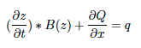
Conservation of Mass
+ρq ΔxΔt
Collapse and simplify (divide by ρΔxΔt)
Notes:
If the same inputs (in an algorithm) produce different results, but similar statistical behavior (stochastic)

Slide 12
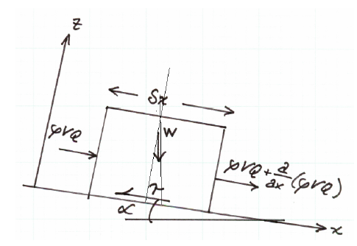
Conservation of Momentum
Change of momentum in the cell is equal to the net momentum entering the cell plus the sum of the forces on liquid in the cell.

